Slide 1
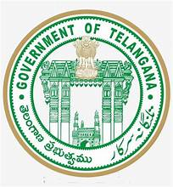
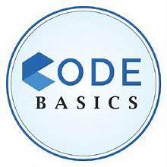
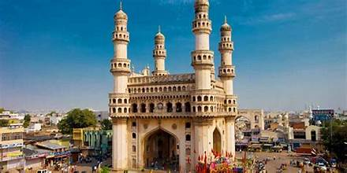
TELANGANA GROWTH ANALYSIS
Presented By
-Pavani Bachina

Slide 2
Agenda
01
02
03
04
About the project
Objective
Primary Insights
Secondary Insights

Slide 3
ABOUT THE PROJECT
Telangana is one of the fastest-growing states in India and one of the states with an open data policy.
Peter Pandey is an aspiring data analyst looking for a project with real-time data to add to his portfolio. He wanted to analyse Telangana’s growth among different sectors quantitatively and provide useful Insights to the Telangana government that would help them to make data-informed decisions that would further support the growth of the state.

Slide 4
OBJECTIVE
Explore Stamp Registration, Transportation and Ts-Ipass Datasets. Understand their attributes, categories and time period.
Analyze trends and patterns within each department.
Identify growth opportunities and areas needing attention.
Find correlation among these departments and report the overall growth of the state through insights and relevant visuals such as shape maps.

Slide 5

PRIMARY INSIGHTS
Stamp Registration
Transportation
TS-IPASS

Slide 6

ESTAMPS
E-Stamp duty in Telangana-Assessment, Management & Payment System
eSTAMPS was launched by the Registration and Stamps Department, Telangana on 11th April, 2016. eSTAMPS refers to the stamp duty, transfer duty, registration fees and user charges paid by the public to register any deed. User now has the convenience of paying the stamp duty from anywhere. This system is user friendly, hassle free and convenient as the citizen saves time and pays the stamp duty from the comfort of his home/office/anywhere.

Slide 7
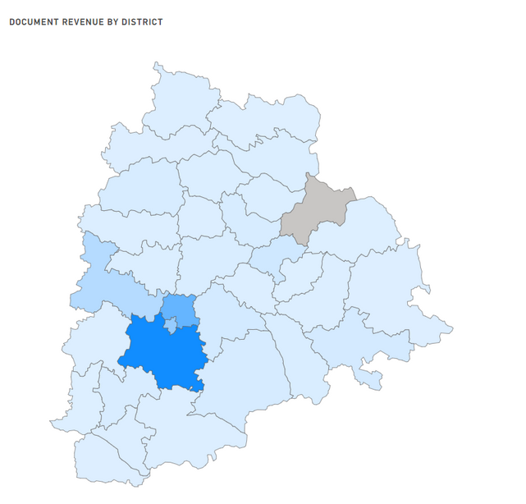
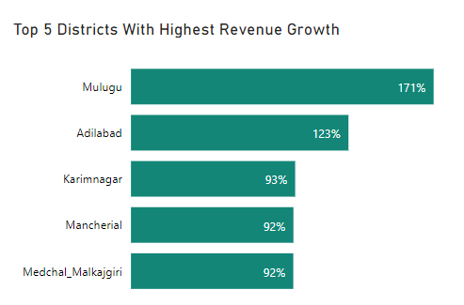
How does the revenue generated from document registration vary across districts in Telangana? List down the top 5 districts that showed the highest document registration revenue growth between FY 2019 and 2022
In Telangana, Rangareddy generates the highest revenue through document registration with 37%.
Medchal_Malkajgiri(22%), Hyderabad(13%) and Sangareddy(7.5%) come next.
Jayashankar Bhupalpally receives no revenue from document registration.
Mulugu district reports a phenomenal 171% increase in revenue from document registration.
Adilabad and Karimnagar came next, both with 123% and 93% growth, respectively.
The revenue growth for Mancherial and Medchal Malkajgiri is over 92%.

Slide 8
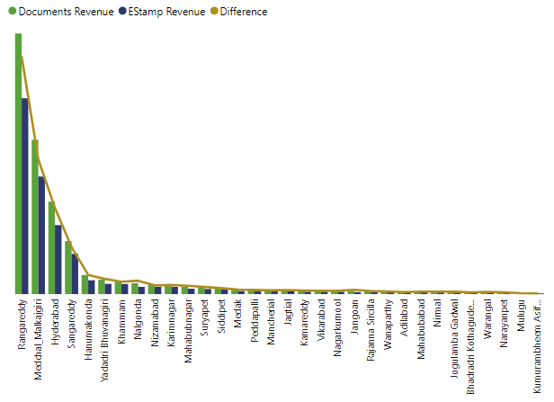
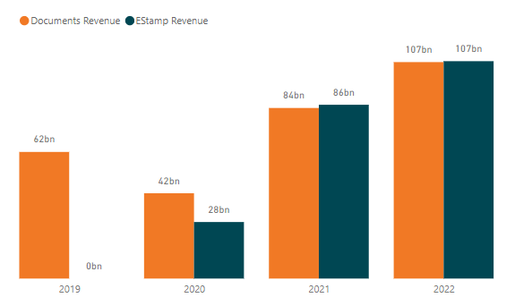
How does the revenue generated from document registration compare to the revenue generated from e-stamp challans across districts? List down the top 5 districts where e-stamps revenue contributes significantly more to the revenue than the documents in FY 2022?
We can find that the revenue generated from document registration is more than the revenue generated from e-stamp challans for every district.
In 2019, there is no revenue generated from EStamp challans.
The income generated by EStamp challans rises in 2020, whereas the revenue generated by document registration falls.
The revenue from EStamp challans as well as Document registration both rise in 2021 and 2022.In addition to document registration, the EStamp Challan generates additional money.

Slide 9
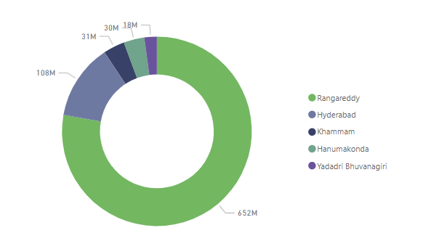
How does the revenue generated from document registration compare to the revenue generated from e-stamp challans across districts? List down the top 5 districts where e-stamps revenue contributes significantly more to the revenue than the documents in FY 2022?
Rangareddy: The revenue generated from the EStamp challan is 38349357618 and the document registration revenue is 37697750946. So the difference is 651606672 which is the highest difference among all the districts.
Hyderabad: The revenue generated from the EStamp challan is 14374315032 and the document registration revenue is14266012441. So the difference is 108302591.
Khammam: The revenue generated from the EStamp challan is 2002220314and the document registration revenue is 1971647539. So the difference is 30572775.
Hanumakonda: The revenue generated from the EStamp challan is 2846856844 and the document registration revenue is 2817238587. So the difference is 29618257.
Yadadri Bhuvanagiri: The revenue generated from the EStamp challan is 2185270667 and the document registration revenue is 2167480603. So the difference is 17790064.

Slide 10
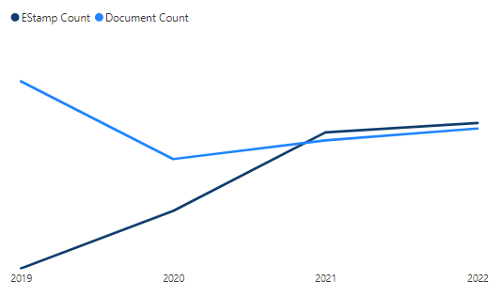
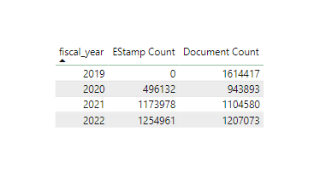
Is there any alteration of e-Stamp challan count and document registration count pattern since the implementation of e-Stamp challan? If so, what suggestions would you propose to the government?
No EStamp challan count has been recorded for 2019 yet.
The EStamp challan count, however, grew steadily starting in 2020.
The number of documents registered exceeds the number of EStamp challans till 2020.
However, starting in 2021, there are more EStamp Challans than documents registered count.
Suggestions:
Raising awareness of EStamps and their advantages.
Improving user friendliness of the EStamp.
Keeping the balance between document registration and the EStamp Challan. Because document registration generates more money than EStamp does.
Enhancing the website's security.

Slide 11
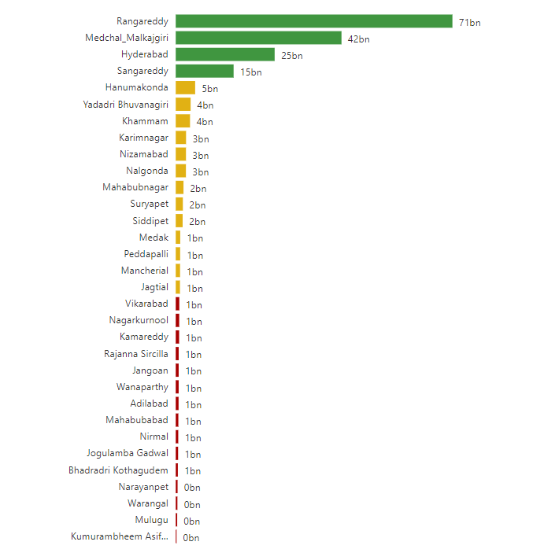
Categorize districts into three segments based on their stamp registration revenue generation during the fiscal year 2021 to 2022
Category 1(>10bn): Rangaredy, Medchal Malkajgiri, Hyderabad, Sangareddy
Category 2(>1bn): Hanumakonda, Yadadri Bhuvanagiri, Khammam, Karimnagar, Nizamabad, Nalgonda, Mahabubnagar, Suryapet, Siddipet, Medak, Peddapalli, Mancherial, Jagtial
Category 3(<1bn): Vikarabad, Nagarkurnool, Kamareddy, Rajanna Siricilla, Jangoan, Wanaparthy, Adilabad, Mahabubabad, Nirmal, Jogulamba Gadwal, Bhadradri Kothagudem, Narayanpet, Waranagal, Mulugu, Kumurambheem Asifabad

Slide 12
TRANSPORTATION

Slide 13
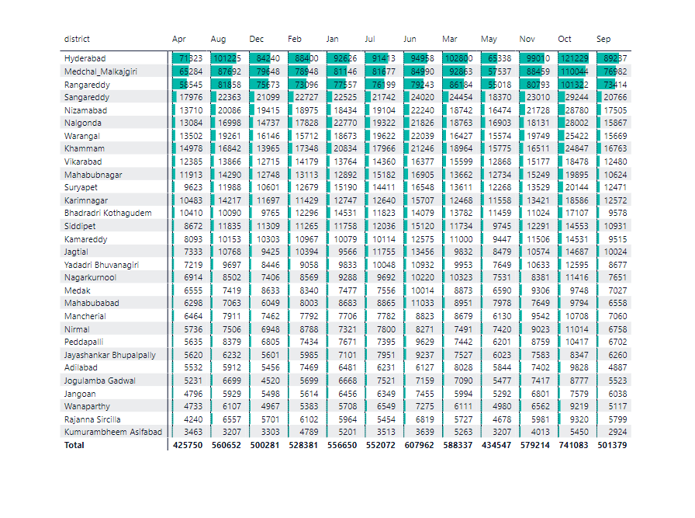
Investigate whether there is any correlation between vehicle sales and specific months or seasons in different districts. Are there any months or seasons that consistently show higher or lower sales rate, and if yes, what could be the driving factors? (Consider Fuel-Type category only)
Yes, there is a correlation between vehicle sales and seasons. Vehicle sales are typically higher in the winter and lower in the summer. As the population of a district increases, there is a higher likelihood of increased vehicle sales. The largest vehicle sales in Telangana were recorded in Hyderabad, Medchal Malkajgiri, Rangareddy, and Sangareddy.
October and June have the highest sales rate in Telangana
April and May have lowest vehicle sales rate in Telangana

Slide 14
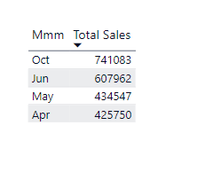
Investigate whether there is any correlation between vehicle sales and specific months or seasons in different districts. Are there any months or seasons that consistently show higher or lower sales rate, and if yes, what could be the driving factors? (Consider Fuel-Type category only)
Highest vehicle sales:
June can see higher sales, as families and students prepare for the new school year, work and some may purchase vehicles for commuting to school or college.
October and June have the highest sales rate in Telangana. In Telangana major festival Dussehra is celebrated in the month of October. Many people consider this occasion auspicious for making significant purchases, including vehicles.
Lowest vehicle sales:
Telangana experiences extreme summer heat in the months of April and May. Vehicle sales may slow down during the hottest months as potential buyers may prefer to avoid outdoor activities, including visiting dealerships.
Even fuel prices tend to be higher during the summer months.

Slide 15
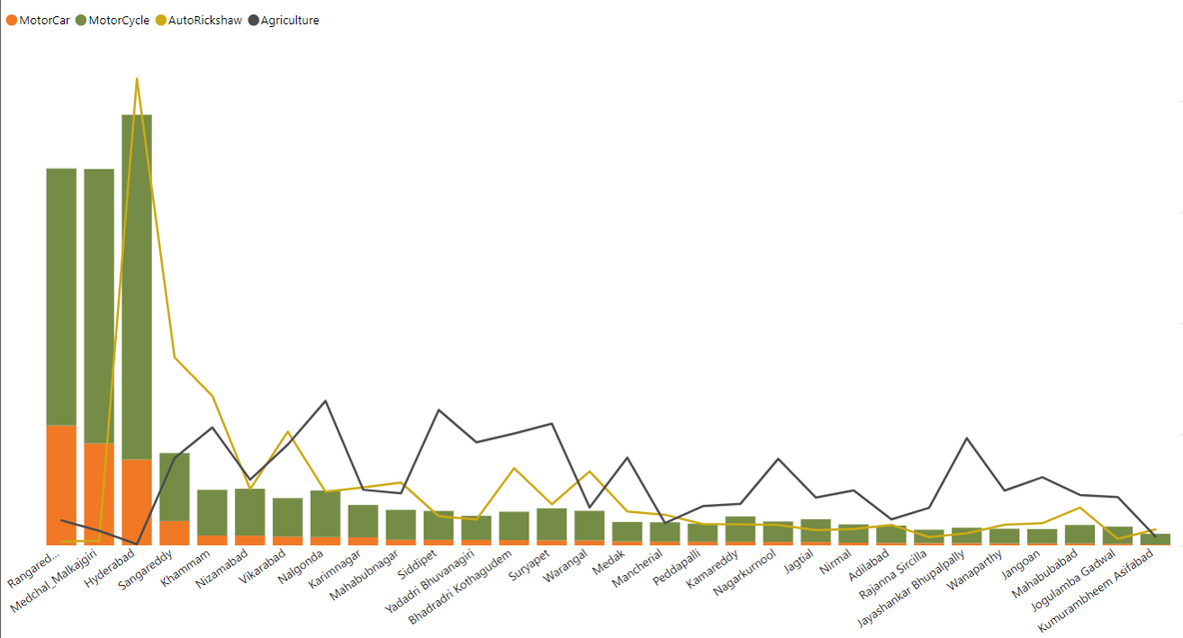
How does the distribution of vehicles vary by vehicle class (MotorCycle, MotorCar, AutoRickshaw, Agriculture) across different districts? Are there any districts with a predominant preference for a specific vehicle class? Consider FY 2022 for analysis.
MotorCycle: Due to its affordability, convenient parking, and convenience of travel, motorcycles are favored by the majority of people. Medchal-Malkajgiri (17%), Rangareddy (16%), Hyderabad (22%) and Sangareddy (4%) prefer motorcycles.
MotorCar: People prefer MotorCar due to its flexibility, efficiency and convenience. This vehicle class is preferred by Rangareddy (26%), Medchal_Malkajgiri (23%), Hyderabad (19%), and Sangareddy (5.5%).
AutoRickshaw: Auto Rickshaws are convenient and reasonably priced. Most residents of Hyderabad (27%) prefer this Vehicle class, followed by Sangareddy (11%), Khammam (8.8%), and Vikarabad (6.7%).
Agriculture: This vehicle class is preferred by Nalgonda (7.3%), Siddipet (7.0%), Suryapet (6.3%), Khammam (6.0%), and Bhadradri Kothagudem (5.7%). As agriculture is the primary source of revenue for these districts.

Slide 16
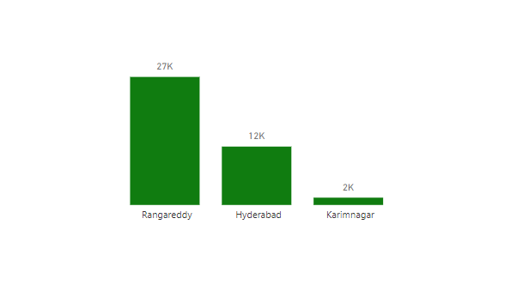
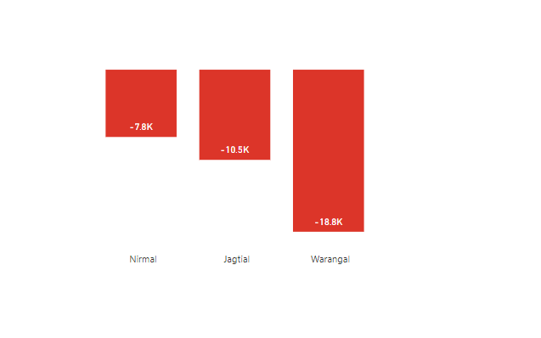
List down the top 3 and bottom 3 districts that have shown the highest and lowest vehicle sales growth during FY 2022 compared to FY 2021? (Consider and compare categories: Petrol, Diesel and Electric)
Top 3 districts with highest sales growth during FY 2022 and FY 2021
Rangareddy: This district saw the most substantial sales growth with 13%.
Hyderabad: This district has shown a growth of 5% of sales.
Karimnagar: This district has an increase of 4% sales.
Bottom 3 districts with lowest sales growth during FY 2022 and FY 2021
Warangal: This district has a 45% drop in sales.
Jagtial: The sales have dropped by 37% in this distict .
Nirmal: This district has a decrease in sales of 34%.

Slide 17
TS-IPASS
Telangana State Industrial Project Approval and Self Certification System
The Telangana Government has enacted the “Telangana State Industrial Project Approval and Self-Certification System (TS-iPASS) Act, 2014” (Act No.3 of 2014) for speedy processing of applications for issue of various clearances required for setting up of industries at a single point based on the self-certificate provided by the entrepreneur and also to create investor friendly environment in the State of Telangana.

Slide 18
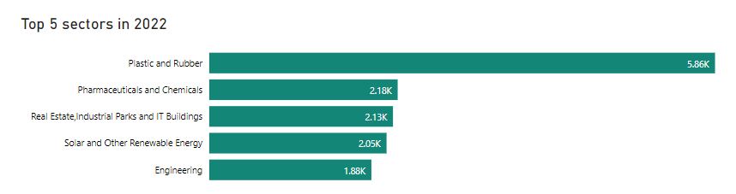
List down the top 5 sectors that have witnessed the most significant investments in FY 2022.
The top 5 sectors that have witnessed the most investments in 2022 are:
Plastic and Rubber: The sector with the most investment, contributing 22.7% of all investments in 2022.
Pharmaceuticals and Chemicals: This sector contributes to 8.5% in 2022.
Real Estate, Industrial Parks and IT Buildings: This sector contributes to 8.3% in 2022.
Solar and Other Renewable Energy: This sector contributes to 8.0% in 2022.
Engineering: This sector contributes to 7.3% in 2022.

Slide 19
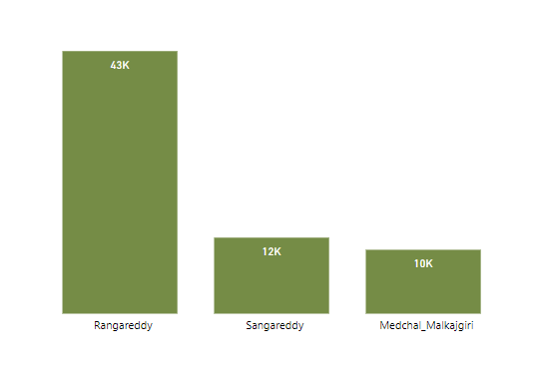
List down the top 3 districts that have attracted the most significant sector investments during FY 2019 to 2022? What factors could have led to the substantial investments in these particular districts?
Rangareddy : Rangareddy district, which surrounds Hyderabad, has also seen substantial sector-specific investments due to its proximity to the capital city. The district is home to various IT and business parks, making it an attractive location for IT and ITES companies.
Sangareddy: This district receives investments worth 12.5% of the total. Three large public sector businesses are located in the city. These are Ordnance Factory Medak, BDL, and BHEL. With adjacent districts like Hyderabad, Medchal Malkajgiri, and Rangareddy, this one is well linked.
Medchal_ Malkajgiri : This district, located in the northern part of the Hyderabad metropolitan area, has experienced growth in the pharmaceutical and biotechnology sectors. Several pharmaceutical companies and research institutions have set up operations in this district.

Slide 20
List down the top 3 districts that have attracted the most significant sector investments during FY 2019 to 2022? What factors could have led to the substantial investments in these particular districts?
Factors:
Skilled Workforce: The availability of a skilled and educated workforce, particularly in information technology and pharmaceutical sectors, has been a significant factor. The presence of reputed educational institutions and research centers has attracted talent from across the country.
Government Policies and Incentives: The Telangana government has introduced policies and incentives to promote industrialization and investment in key sectors. Initiatives like the Telangana Industrial Policy, offering land and power subsidies, have encouraged businesses to set up operations in the region.
Infrastructure Development: Ongoing infrastructure development, including the expansion of road networks, the establishment of industrial parks and special economic zones (SEZs), and improvements in digital connectivity, has made the districts more attractive for businesses.
Quality of Life: The overall quality of life in these districts, including factors like healthcare facilities, educational institutions, and cultural amenities, has made them attractive destinations for professionals and their families.
Logistical Advantages: The strategic location of these districts, with access to major transportation routes and ports, has made them favorable for logistics and warehousing investments.

Slide 21
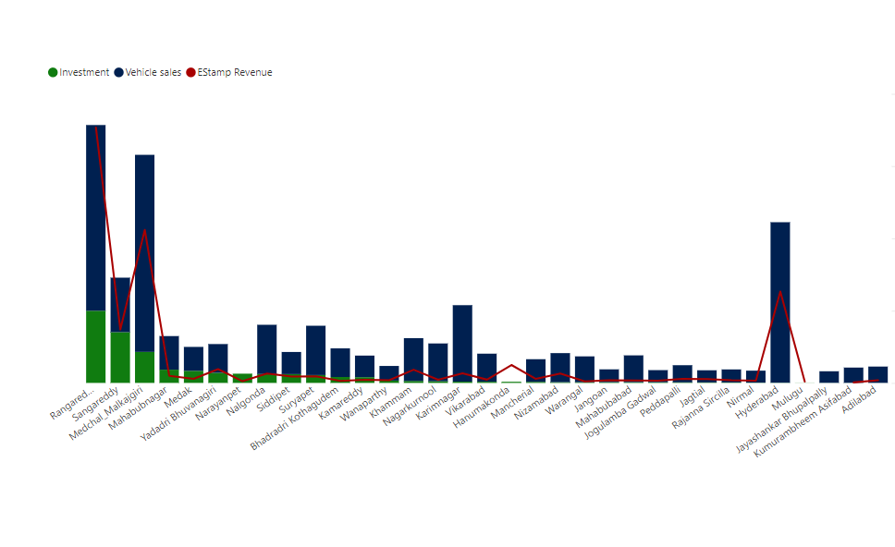
Is there any relationship between district investments, vehicles sales and stamps revenue within the same district between FY 2021 and 2022?
We can observe that district investments, vehicle sales and stamps revenue are directly related to each other.
District Investments : District investments, which might come from the public and private sectors, can encourage economic growth there. When companies invest in services, manufacturing facilities, or infrastructure, it frequently results in the creation of jobs and a rise in the district's economic activity.
Vehicle Sales: Consumer spending may rise when economic activity and income levels rise in a district. As a result, more vehicles, including automobiles and commercial trucks, may be purchased as individuals and corporations have more money to spend on transportation.
Stamps Revenue: The government collects stamp duty and registration fees when properties and other types of legal documents are registered. When the economy is expanding, there are frequently more real estate transactions, which might lead to higher stamp sales.

Slide 22
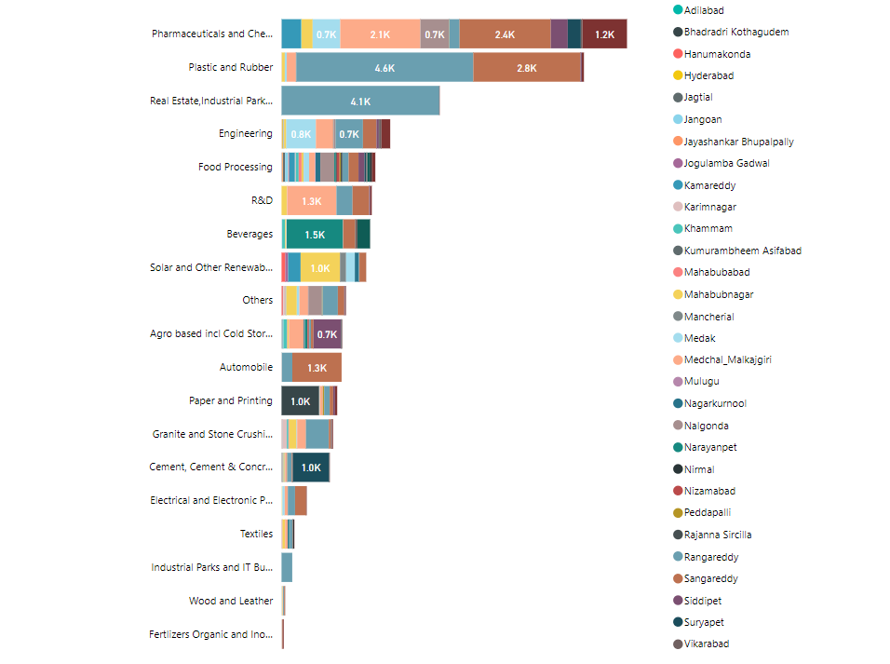
Are there any particular sectors that have shown substantial investment in multiple districts between FY 2021 and 2022?
The Electrical and Electronic Products sector has investments in Sangareddy, Rangareddy, Medchal Malkajgiri and Medak.
Wood and Leather has investments in Rangareddy, Sangareddy, Mahabubnagar and Medchal Malkajgiri.
Engineering has investments in Medak, Rangareddy, Medchal Malkajgiri and Sangareddy.
Textiles has investments in Rangareddy, Mahabubnagar, Medchal Malkajgiri and Warangal.
Granite and Stone Crushing has investments in Rangareddy, Medchal Malkajgiri and Mahabubnagar.
Pharmaceuticals and Chemicals has investments in Sangareddy, Medchal Malkajgiri and Yadadri Bhuvanagiri
R&D has investments in Medchal Malkajgiri, Sangareddy and Rangareddy
Solar and Other Renewable Energy has investments in Mahabubnagar, Kamareddy and Medak.
Beverages has investments in Narayanpet, Wanaparthy and Sangareddy.

Slide 23
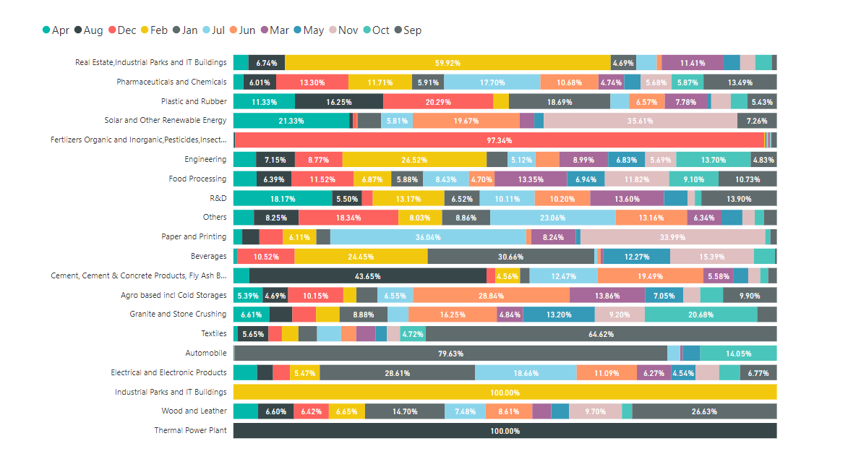
Can we identify any seasonal patterns or cyclicality in the investment trends for specific sectors? Do certain sectors experience higher investments during particular months?

Slide 24
Can we identify any seasonal patterns or cyclicality in the investment trends for specific sectors? Do certain sectors experience higher investments during particular months?
Yes, we can identify seasonal patterns in the investment trends for specific sectors. Few of them are:
The Real Estate, Industrial Parks and IT Buildings sector indicate substantial investment in February.
Fertilizers Organic and Inorganic, Pesticides, Insecticides, and Other Related saw considerable investment in December.
July, September, and December are the prime investment months for pharmaceuticals and chemicals.
Plastic and Rubber shows a significant investment in December ,January and August.
Engineering shows peak investment in February and October.
Solar and Other Renewable Energy shows the highest investment in the months of November, April and June.
Paper and Printing shows the highest investment in the months of July and November.
Beverages sector has higher investments in January and February.
Cement, Cement & Concrete Products, Fly Ash Bricks shows higher investments in August and June.
Textiles show peak investment in September.
Automobile show major funding in January.
Granite and Stone Crushing experience higher investments in October and June.
Agro based incl Cold Storages show major funding June and March.

Slide 25

SECONDARY
INSIGHTS

Slide 26
What are the top 5 districts to buy commercial properties in Telangana? Justify your answer.
Hyderabad: Hyderabad is the capital city of Telangana and the economic hub of the state. It offers a wide range of commercial real estate opportunities, including office spaces, retail properties, and industrial spaces. The city's growing IT and tech industries, as well as its status as a major business center, make it a prime location for commercial investments.
Rangareddy: Rangareddy district surrounds Hyderabad and is often considered an extension of the city. It is known for its industrial and commercial zones, making it attractive for businesses looking to be close to the capital but with potentially lower real estate costs.
Sangareddy: This district has been witnessing growth in commercial real estate development due to its strategic location, proximity to Hyderabad, and various industrial and economic activities in the region.
Medchal Malkajgiri: This district is also located in the Hyderabad metropolitan area and has seen significant growth in commercial real estate development. It offers various commercial options for businesses looking to establish a presence in the region.
Hanumakonda: It is located in northern Telangana, and has been experiencing industrial and economic growth. It has become an emerging hub for various industries, including manufacturing and technology, making it a potential location for commercial property investments.

Slide 27
What significant policies or initiatives were put into effect to enhance economic growth, investments, and employment in Telangana by the current government? Can we quantify the impact of these policies using available data?
Industrial Policy: The government has introduced progressive industrial policies such as the Telangana State Industrial Project Approval and Self-Certification System (TS-iPASS) to streamline approvals for setting up industries and reduce bureaucratic processes.
IT and Innovation Hubs: Telangana has established dedicated IT and innovation hubs such as the Hyderabad Information Technology and Engineering Consultancy City (HITEC City) and the T-Hub, which have attracted both domestic and international investments in the technology sector.
Infrastructure Development: The government has invested in infrastructure projects such as the Hyderabad Metro Rail, Outer Ring Road, and development of industrial parks and special economic zones, which have helped in creating a conducive business environment.
Sector-Specific Policies: The government has introduced sector-specific policies and incentives to promote industries such as IT and IT-enabled services, pharmaceuticals, textiles, and renewable energy.
Irrigation Projects: The government invested heavily in irrigation projects like Kaleshwaram Lift Irrigation Project to improve water availability for agriculture, which indirectly contributed to rural employment and economic growth.
These policies resulted in an increase in investors, and stamp sales are up. The development of these businesses has decreased unemployment and boosted vehicle sales.

Slide 28
Provide top 5 Insights & 5 recommendations to Telangana government for sustained growth in the next 5 years based on your analysis.
INSIGHTS:
Industrial Development: Telangana has made efforts to attract investments and launched the "Telangana State Industrial Project Approval and Self-Certification System" (TS-iPASS) to facilitate speedy approvals for industries.
Welfare Schemes: The Telangana government launched several welfare schemes like "Rythu Bandhu", "KCR Kit" aimed at improving the living standards of its residents.
Economic Growth: Telangana has demonstrated rapid growth. Telangana has shown rapid and robust economic growth amidst a global and national economic slowdown.
Rural Employment Generation Programme: The Telangana government launched various rural employment generation programs, such as the MGNREGA (Mahatma Gandhi National Rural Employment Guarantee Act), to provide wage employment to rural households.
Government Policies and Incentives: The Telangana government has introduced policies and incentives to promote industrialization and investment in key sectors. Initiatives like the Telangana Industrial Policy, offering land and power subsidies, have encouraged businesses to set up operations in the region.

Slide 29
Provide top 5 Insights & 5 recommendations to Telangana government for sustained growth in the next 5 years based on your analysis.
RECOMMENDATIONS:
Diversify the economy: Telangana has achieved great strides in industries like IT and pharmaceuticals, but it is crucial to diversify the economy to lessen reliance on certain industries. To build a diverse and resilient economy, the government might concentrate on boosting industries like manufacturing, agriculture, tourism, and renewable energy.
Strengthen infrastructure: For sustained growth, there must be ongoing investment in infrastructure development. More enterprises will be attracted in, productivity will increase, and total economic activity will increase as a result of improvements in connection, logistics, electricity, and transportation.
Enhance skilling programs: A highly qualified workforce that satisfies industry expectations may be ensured by investing in skill development programmes matched with rising industries and technology.
Encourage entrepreneurship and innovation: By creating a supportive environment for start-ups and small enterprises, the government may encourage an entrepreneurial ecosystem.
Promote sustainable development: Including sustainable practises in all areas of business can promote long-term economic prosperity.

Slide 30

THANK YOU
Add more text

